Slide 1


Smart Recipe Suggestion App
Revolutionizing Meal Preparation with AI
-TEAM QUADINNO

Slide 2
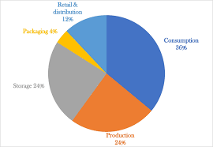
The Problem Statement
Food waste is a global issue; 30-40% of the food supply is wasted annually.
People often struggle to find creative ways to use ingredients at home.
Lack of personalized, efficient meal planning solutions.

Slide 3
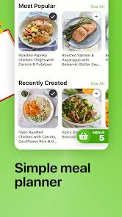
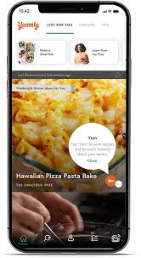

Existing Solutions
Yummly: Recipe suggestions based on user preferences, but lacks waste reduction features.
Mealime: Focus on meal planning, but no integration of ingredient expiration tracking.
SuperCook: Matches recipes with available ingredients, but no personalized or waste management features.
Tasty App: Focused on recipe videos, with no features for leftover or waste management.

Slide 4
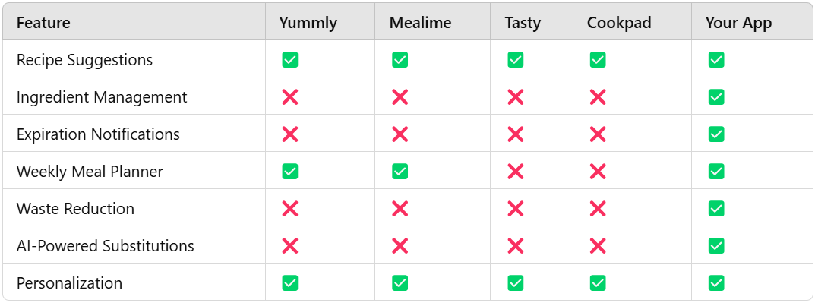
Drawbacks with Existing Solutions

Slide 5
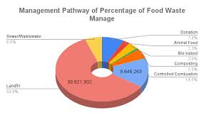
Statistics and Insights
Food Waste Impact:
Every year, approximately 1.3 billion tons of food is wasted globally (FAO report).
Food waste accounts for 8% of global greenhouse gas emissions.
By reducing waste, the app contributes to environmental sustainability and cost savings for users.

Slide 6
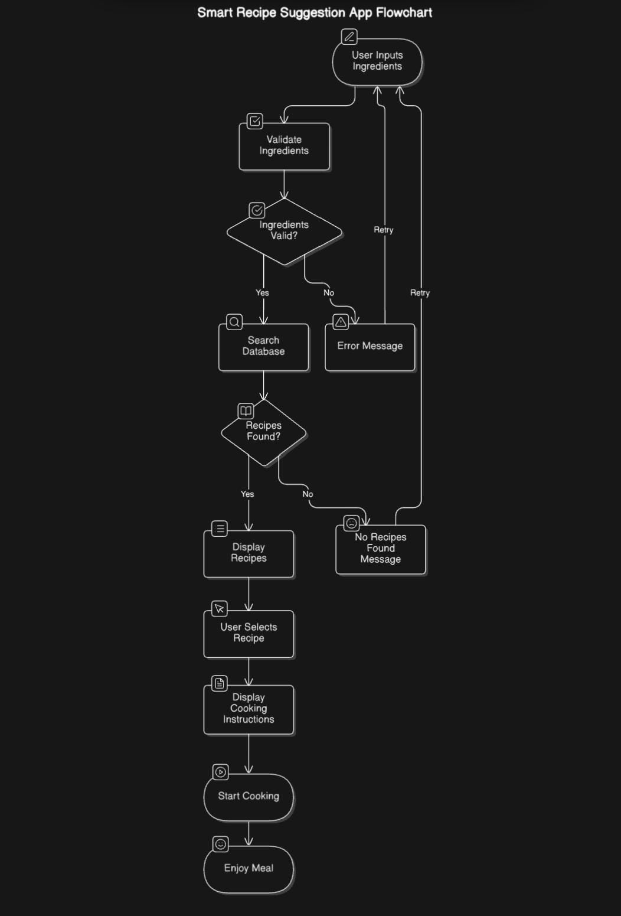
Our Solution
Simplifies meal preparation by providing users with easy, enjoyable recipes based on the ingredients they already have.
Incorporates a weekly meal planner to minimize food waste effectively.
Features advanced personalization options, catering to dietary preferences, cuisines, and calorie requirements.
Offers waste management tools and insights for smarter, sustainable cooking practices.

Slide 7
Features
Ingredient Management: OCR, expiration tracking, notifications.
Recipe Suggestions: Substitutes for missing items, prioritizing expiring ingredients.
Weekly Meal Planner: AI-driven schedules based on availability and dietary needs.
Waste Management: Leftover notifications, waste reduction suggestions.
Personalization: Diet, cuisine, calorie preferences, reviews, and favorites.

Slide 8
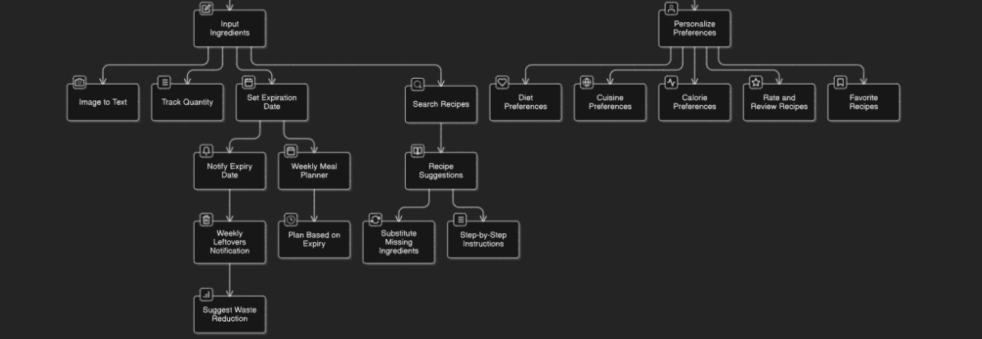
Features Flow

Slide 9
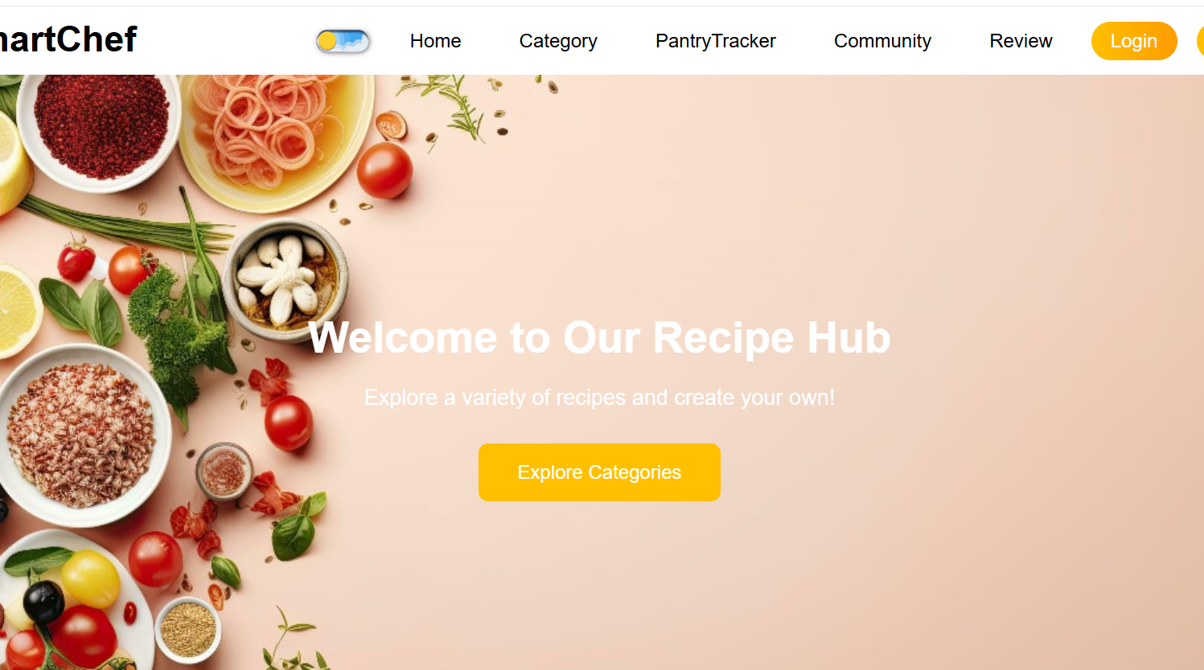
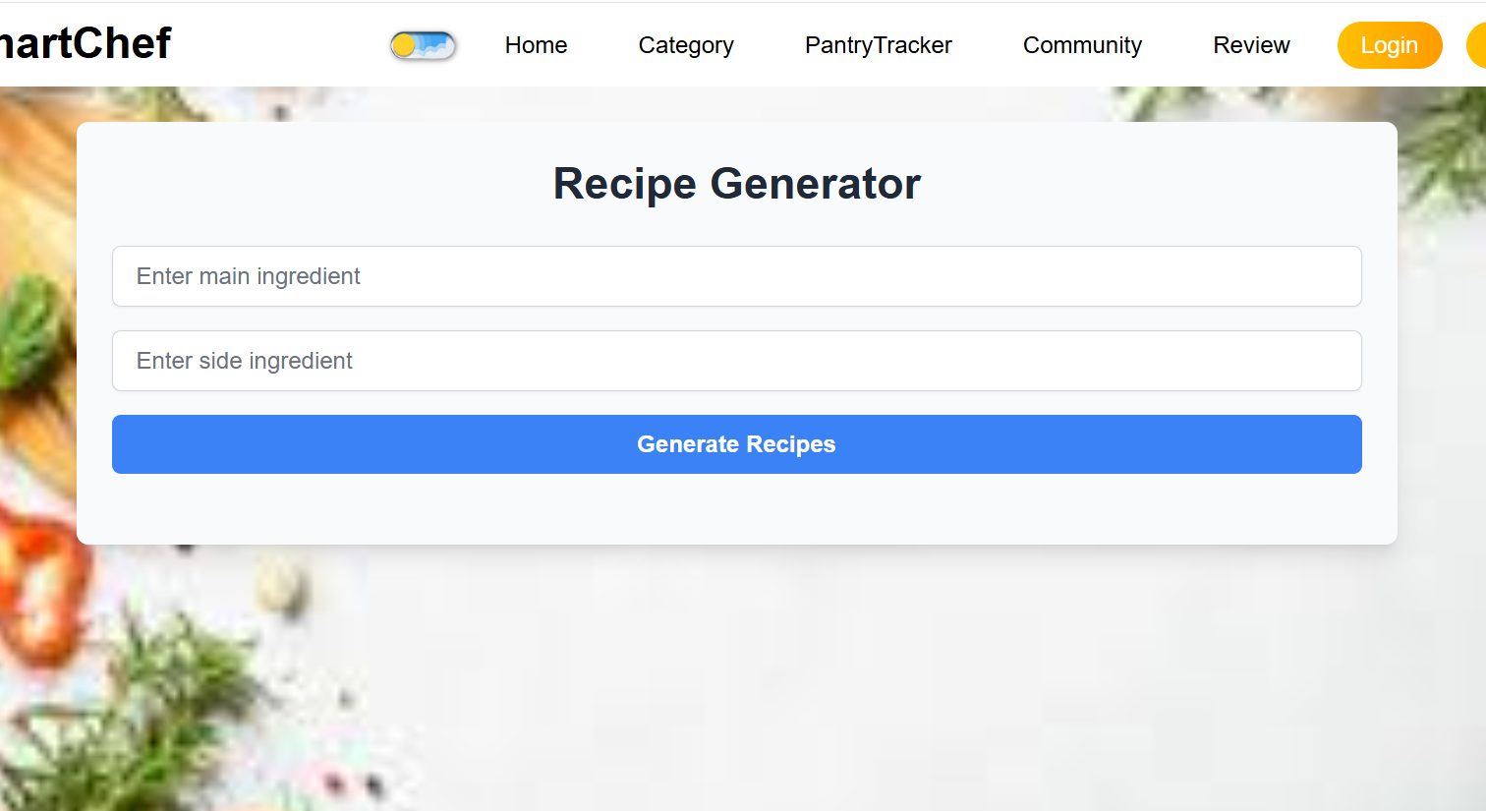
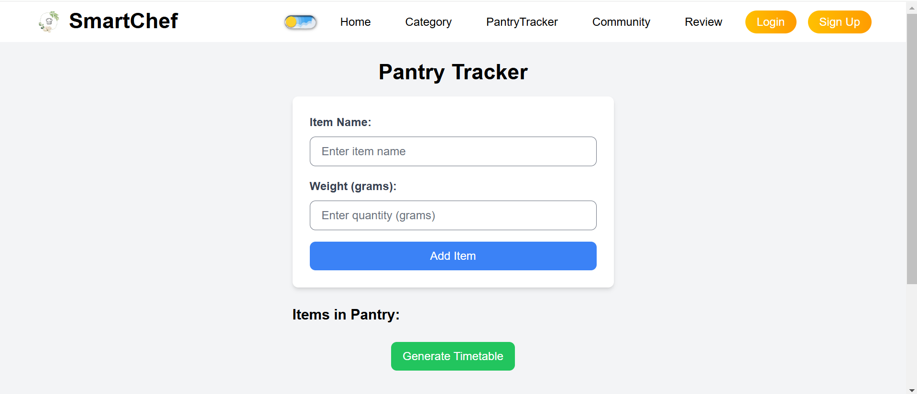
Pretotype

Slide 10
Innovation from Existing Apps
Unlike apps like Yummly or Mealime, our app focuses on ingredient expiration tracking and waste reduction, ensuring no food goes to waste.
It uses AI to suggest ingredient substitutions and manage leftovers creatively, offering recipes tailored to available items.
Additionally, we provide detailed waste analytics, helping users track their habits and reduce waste effectively.
The app also prioritizes sustainability and personalization, making meal planning smarter and more eco-friendly.

Slide 11
Technology Stack
Backend: Node.js
Frontend: React.js, vite, tailwind
Database: MongoDB.
AI/ML: NLP models, OCR (pytesseract, Google Vision API).
Dataset Reference
Expiry Dataset: https://felizang.github.io/expdate/
Recipe Dataset: https://www.kaggle.com/datasets/shuyangli94/food-com-recipes-and-user-interactions

Slide 12
Team Members
Anisha S - 22BCS008
Asfiya Mehrunnisha H - 22BCS013
Krittika V - 22BCS053
Nafila Fathima N - 22BCS069

Slide 13
Reference
https://www.wfp.org/stories/5-facts-about-food-waste-and-hunger
https://www.un.org/en/observances/end-food-waste-day
https://www.unep.org/news-and-stories/press-release/world-squanders-over-1-billion-meals-day-un-report?utm_source=chatgpt.com
https://nanonets.com/blog/ocr-with-tesseract/?utm_source=chatgpt.com
https://firebase.google.com/docs/cloud-messaging/send-message?utm_source=chatgpt.com

Slide 14
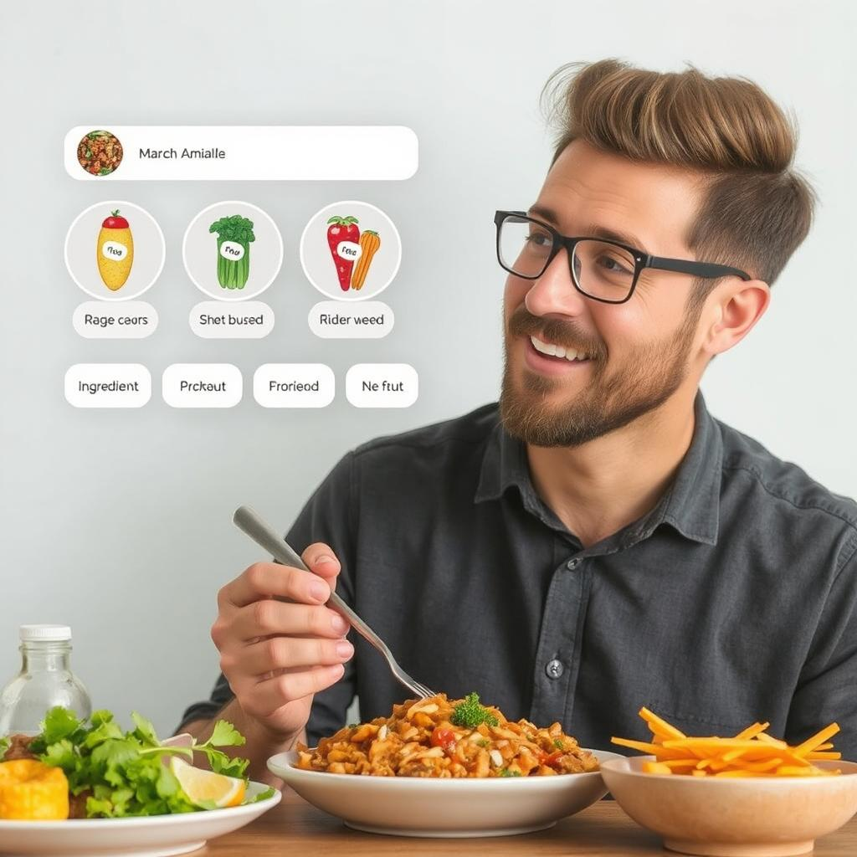
Thank You

